Slide 1
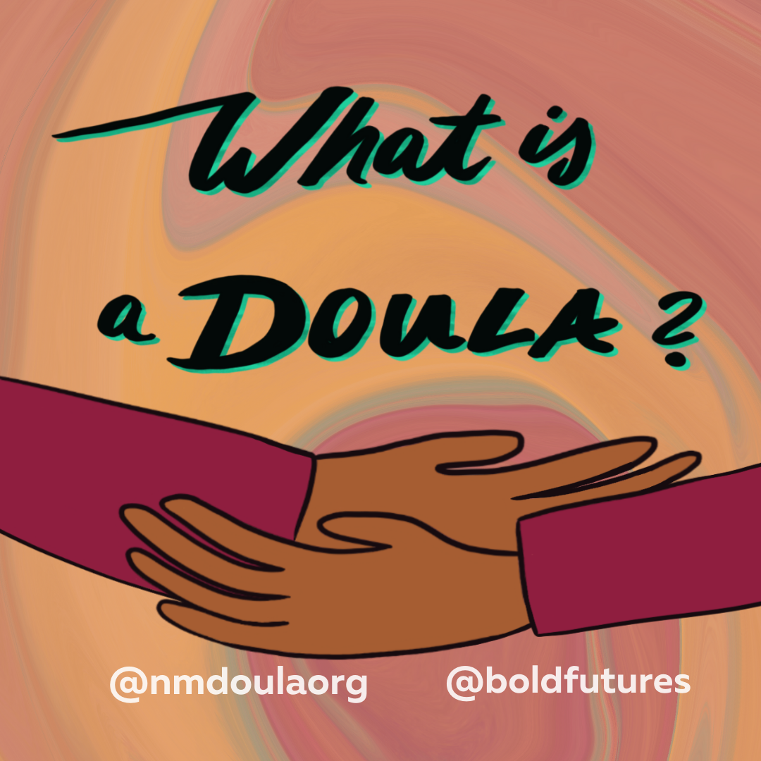
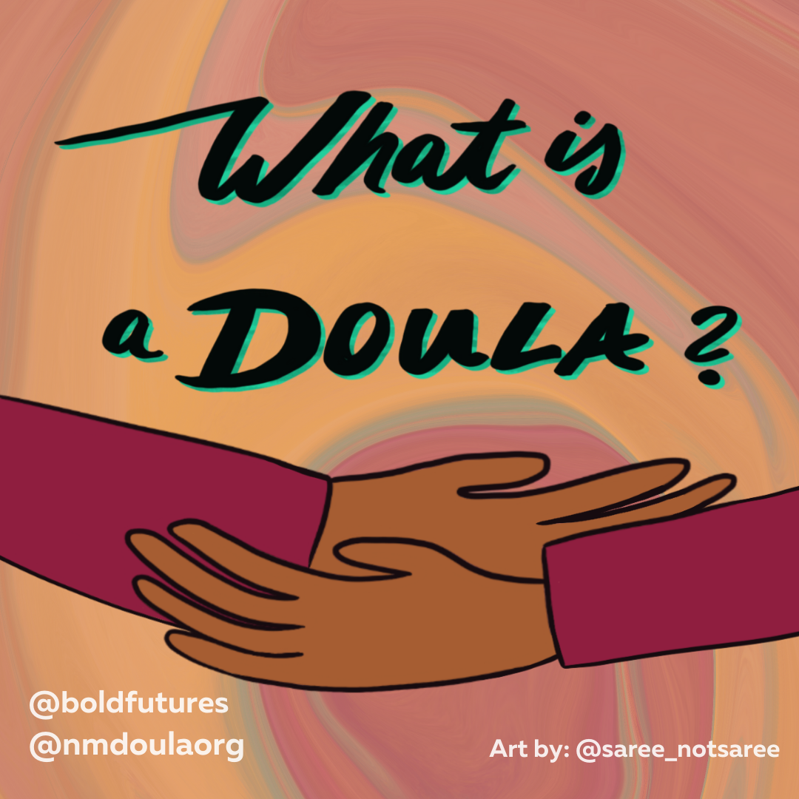
Notes:
Good afternoon, welcome to our poster session of ‘What is a Doula?’

Slide 2
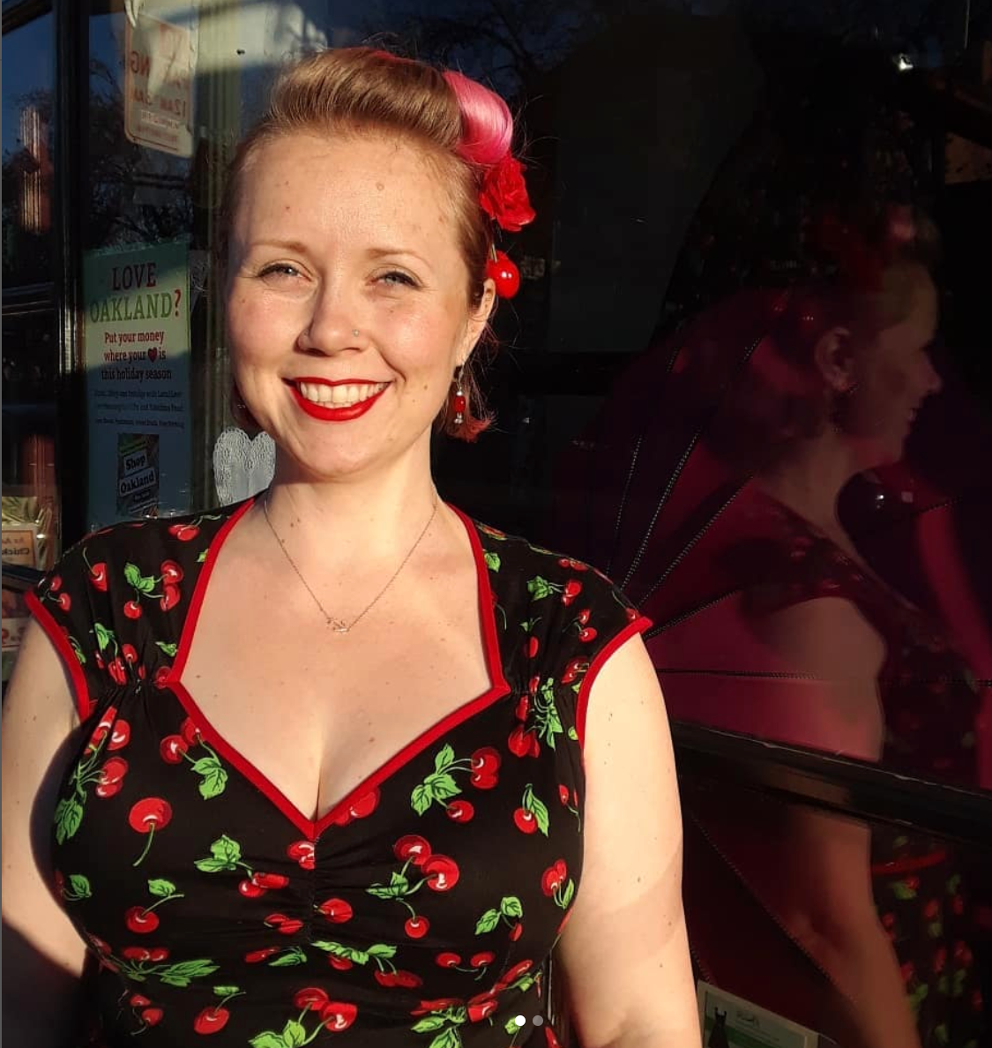
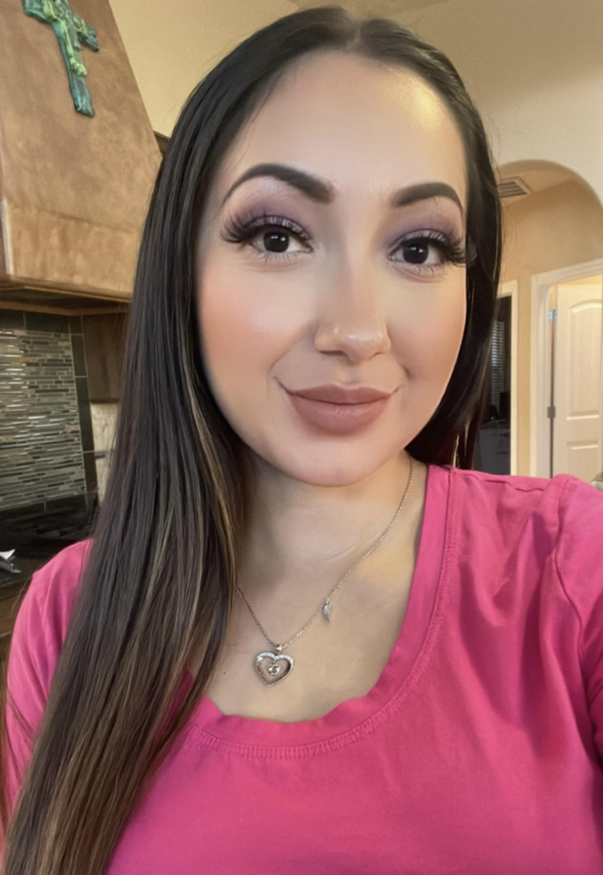
Jesusita Soliz (he/they)
Jesusita is a full-spectrum Doula supporting families in Albuquerque, NM. They are committed to fighting for reproductive justice and holding space for all people in their reproductive journeys.
Kathleen Rojas (she/her)
Kathleen is a bilingual (Spanish/English) full-circle Doula located in Española Valley and supporting families in Northern New Mexico. Her goal is to empower families in all aspects of their prenatal, birth and postpartum experience. She provides pregnancy education, nutritional guidance, physical and emotional labor support, as well as newborn and postpartum care.
Danica Terrones (she/her)
Danica is a full spectrum doula supporting families in Southern New Mexico, with special emphasis on fertility and reproductive sovereignty for all birthing bodies. She has been involved with the “What is a Doula?” campaign in hopes that all New Mexicans will have access to the support and information during pivotal moments of their lives.
Notes:
We are Jesusita, Kathleen and Danica. The three of us stem from diverse backgrounds and are located throughout the state of New Mexico. Each of us has a commitment to reproductive justice and holding space for families as they transition through some of the most pivotal moments of their lives.
We are all members of the New Mexico Doula Association. This is a collaboration between the New Mexico Doula Association, Bold Futures, and the talented graphic designer Leslie Saree. Together we have been working on this campaign since August 2021.

Slide 4
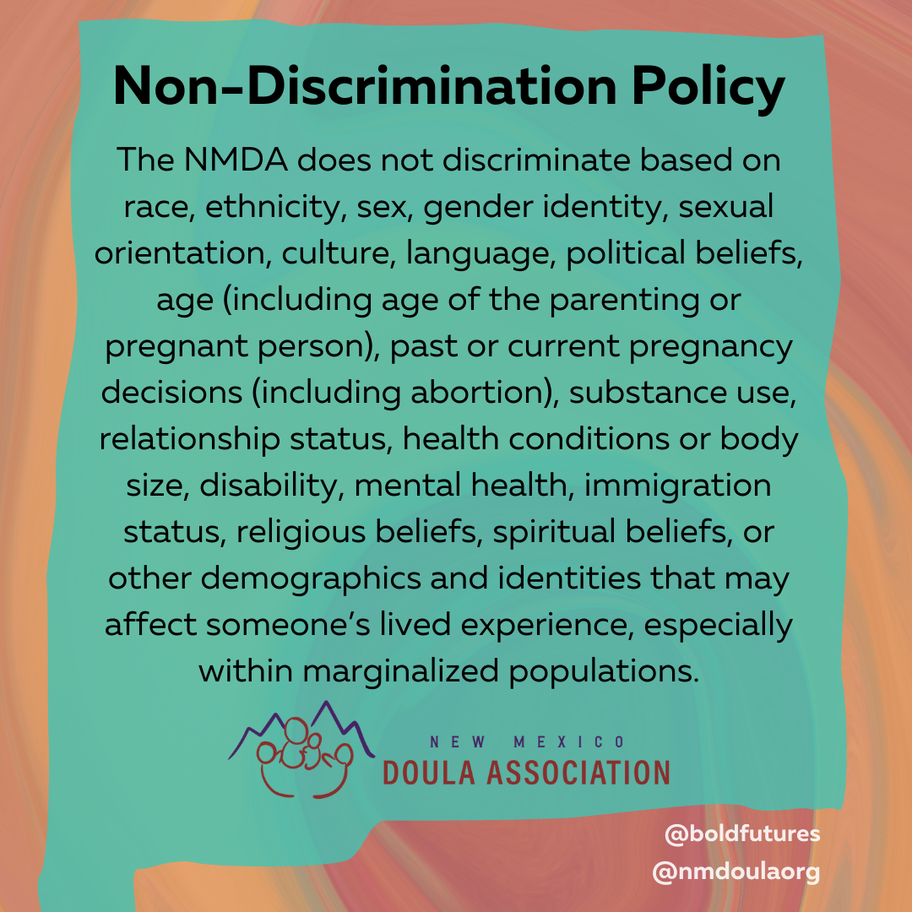
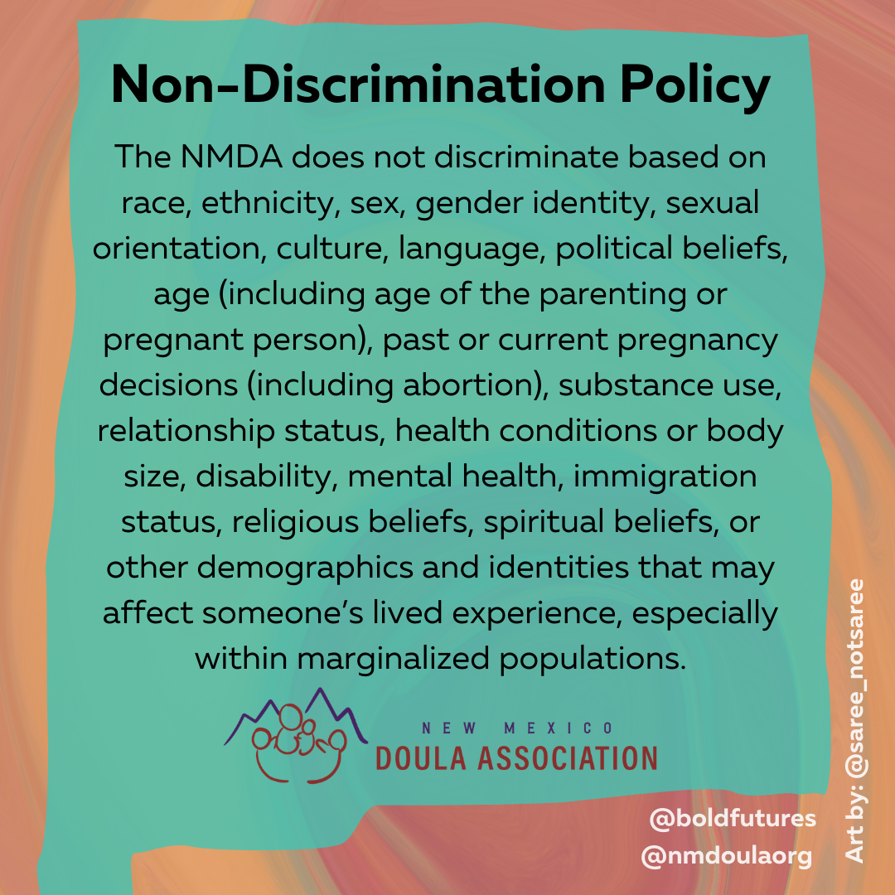

Slide 5
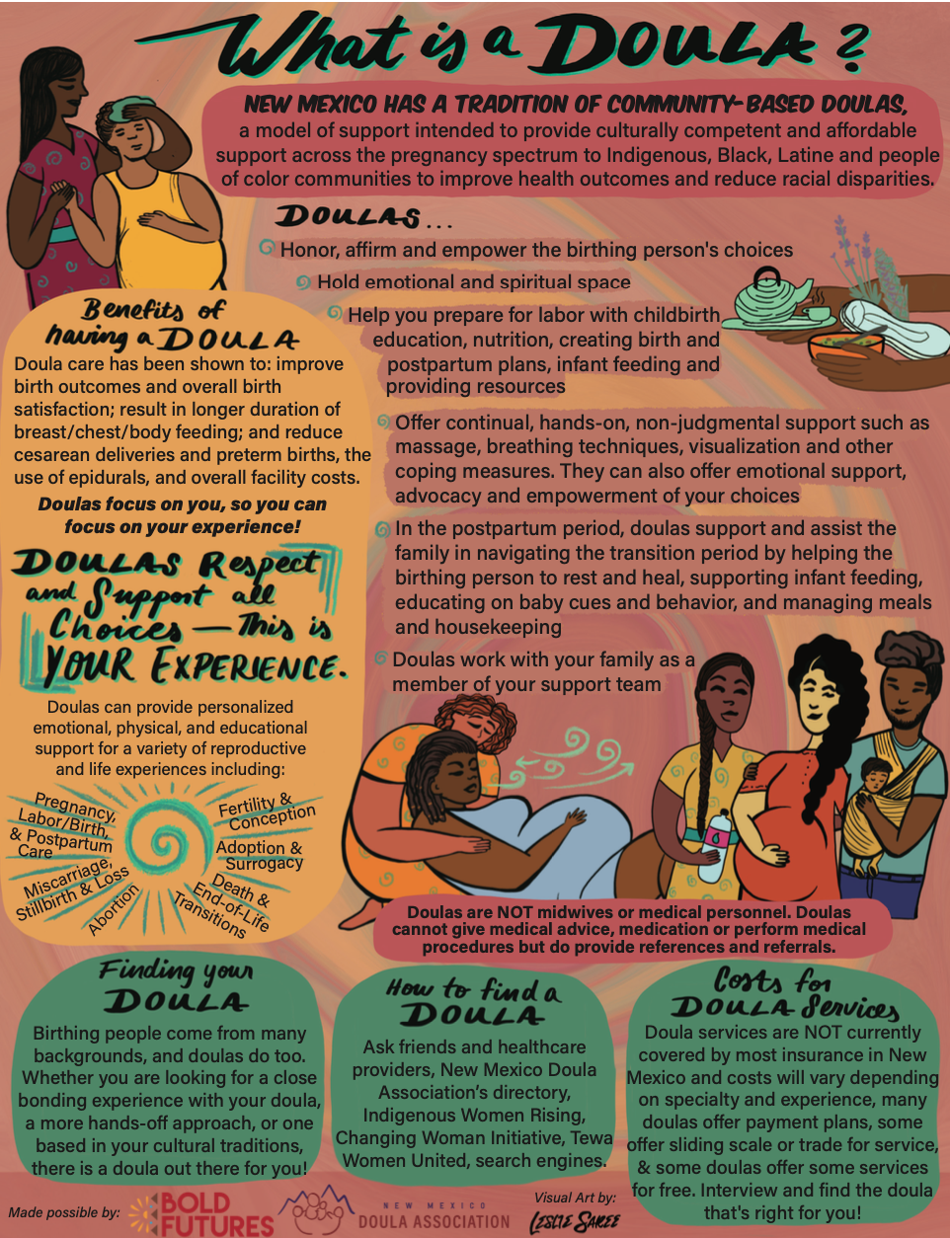
Notes:
This flier is the first piece of the campaign created, with the intention to bring awareness of Doulas, including what a Doula is, what a Doula does and does not do, the different types of doulas, the benefits of having a doula, and how to find a Doula to fit your needs.
We believe Doulas play a valuable role in supporting and connecting communities.

Slide 7
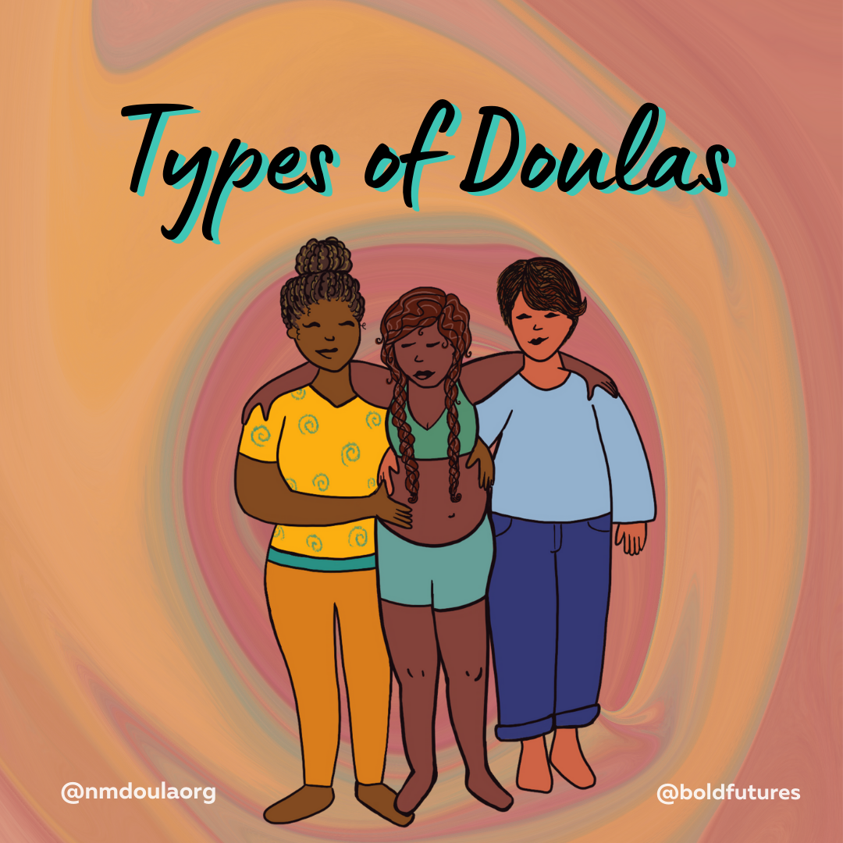
Notes:
Danica in the next slide, we will be highlighting the types of doulas

Slide 8
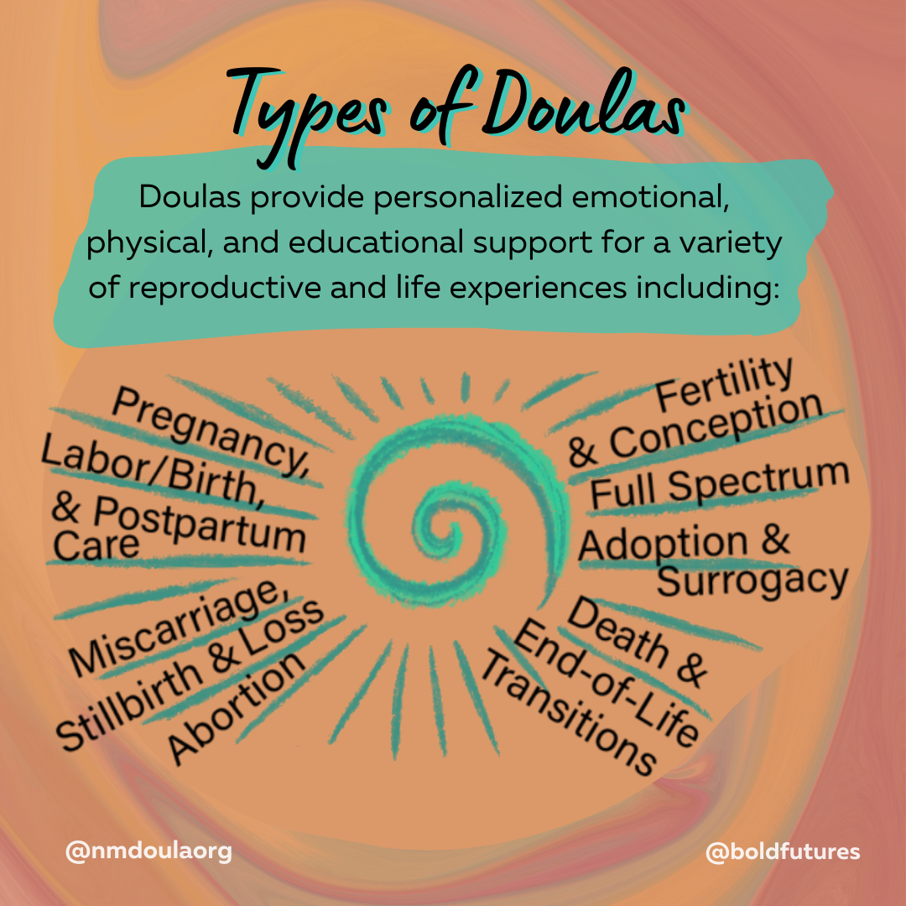
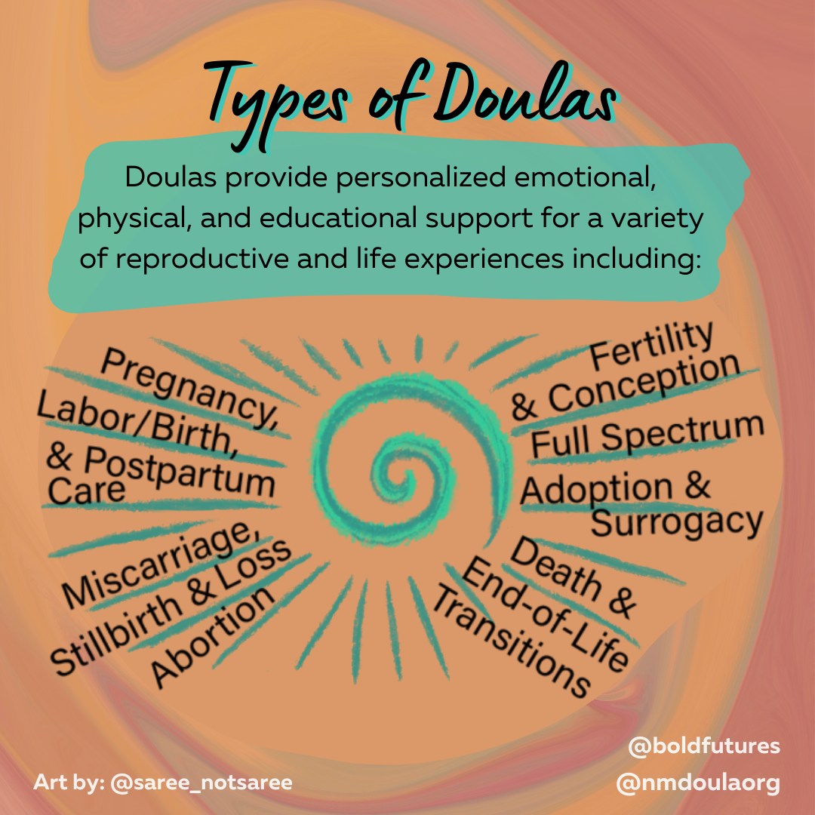
Notes:
There are different types of Doulas, many are listed on this slide. Doulas provide personalized emotional, physical and educational support for a variety of reproductive and life experiences.

Slide 9
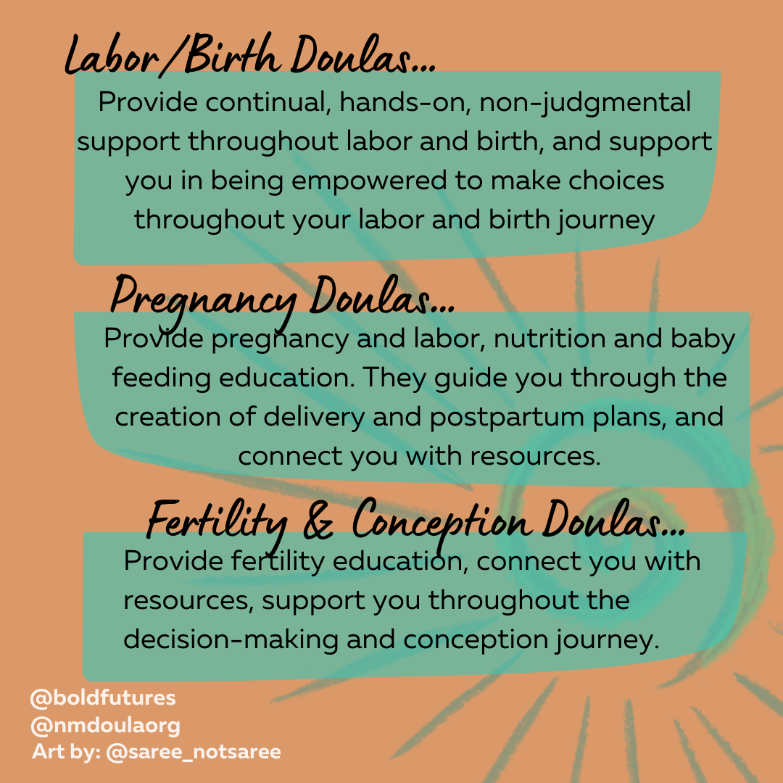

Slide 10
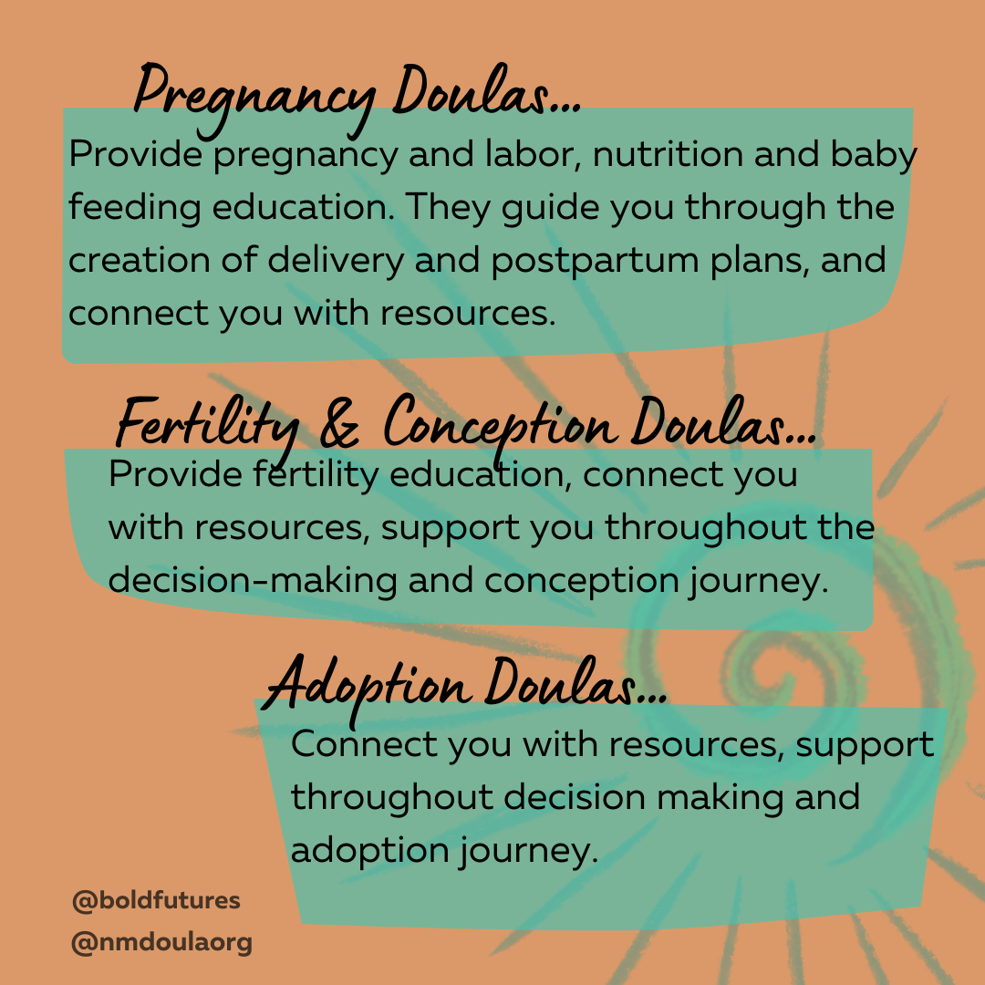
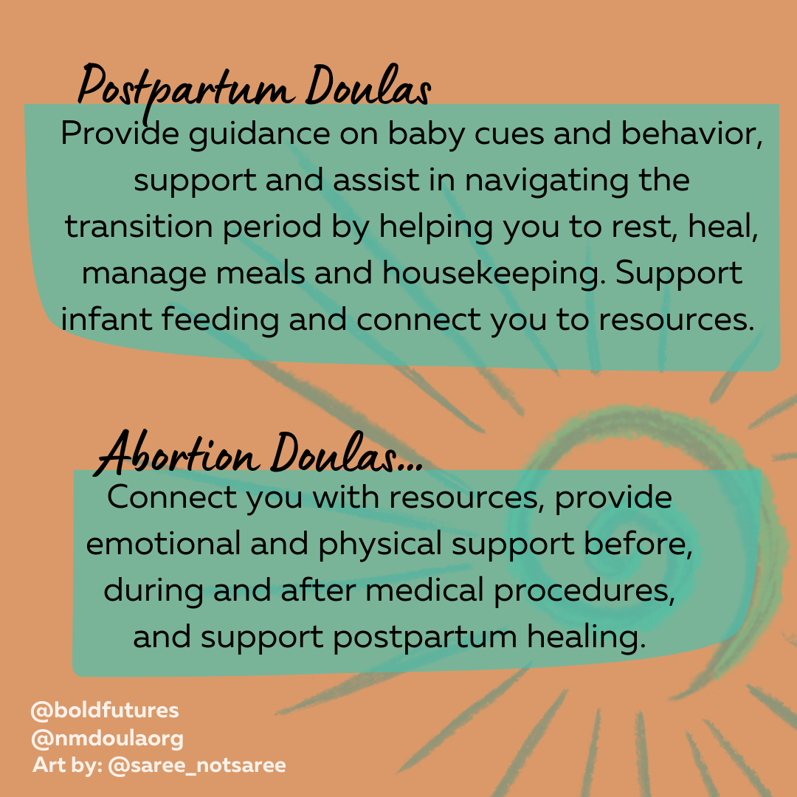
Notes:
Mention to Leslie – edit this to add postpartum

Slide 11
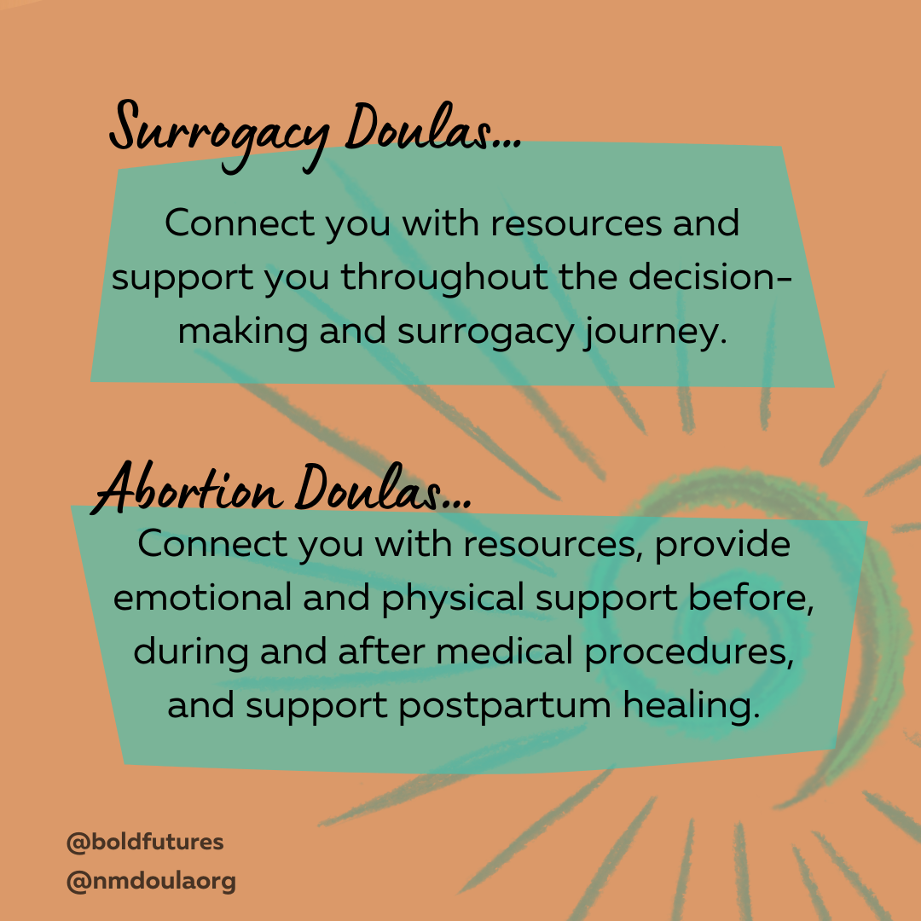

Slide 13
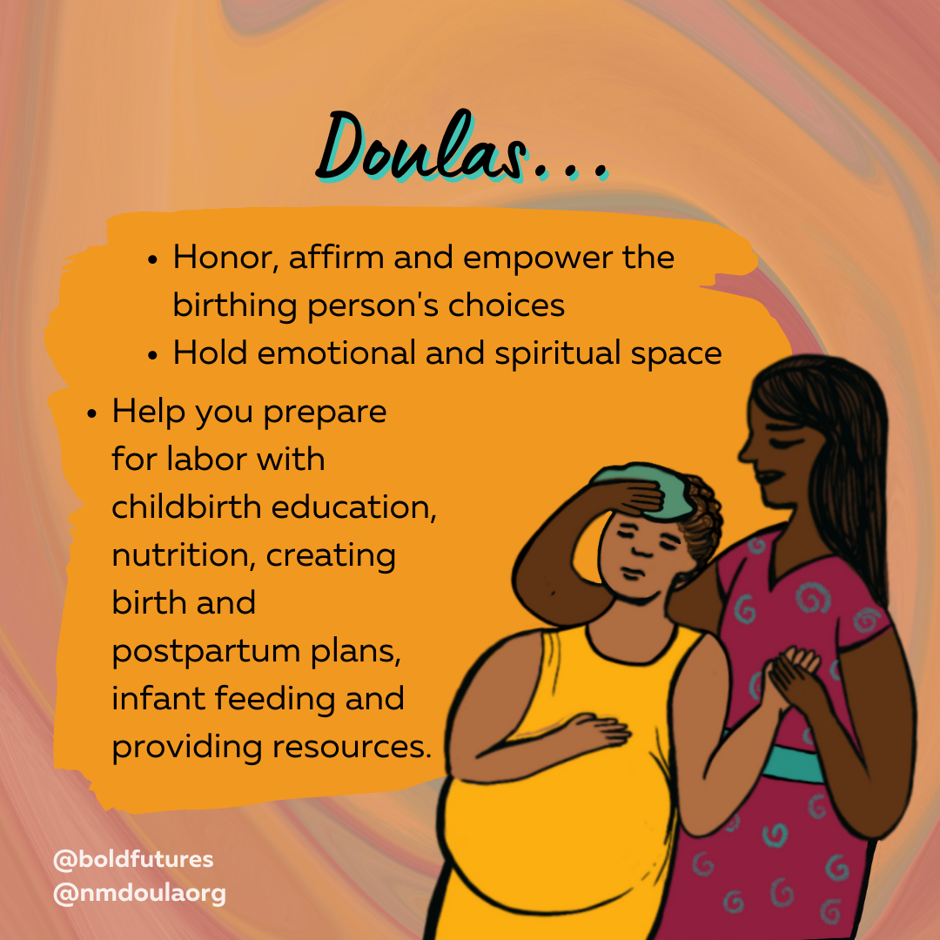
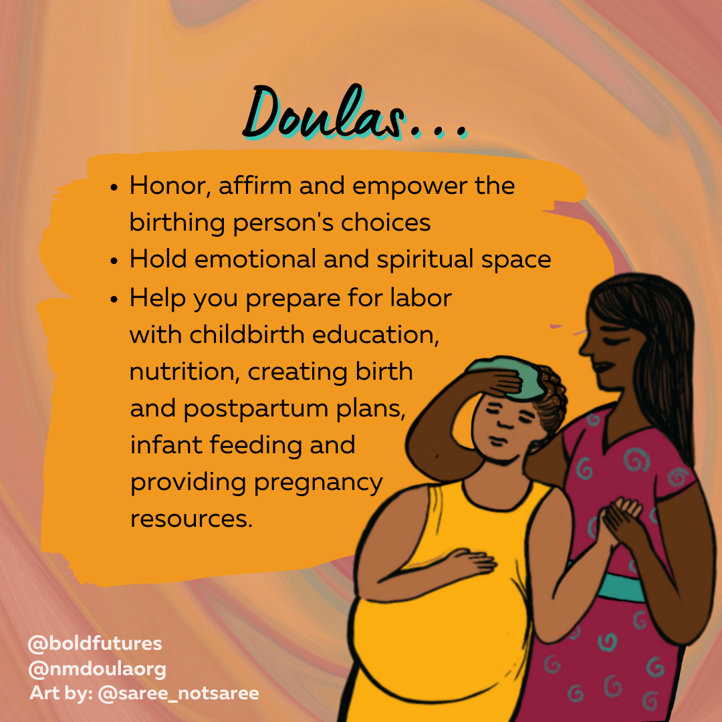
Notes:
Kathleen
As there are a variety of roles that Doulas hold, here we elaborate on some of the specific supports a birth and postpartum doula may provide their client.

Slide 14
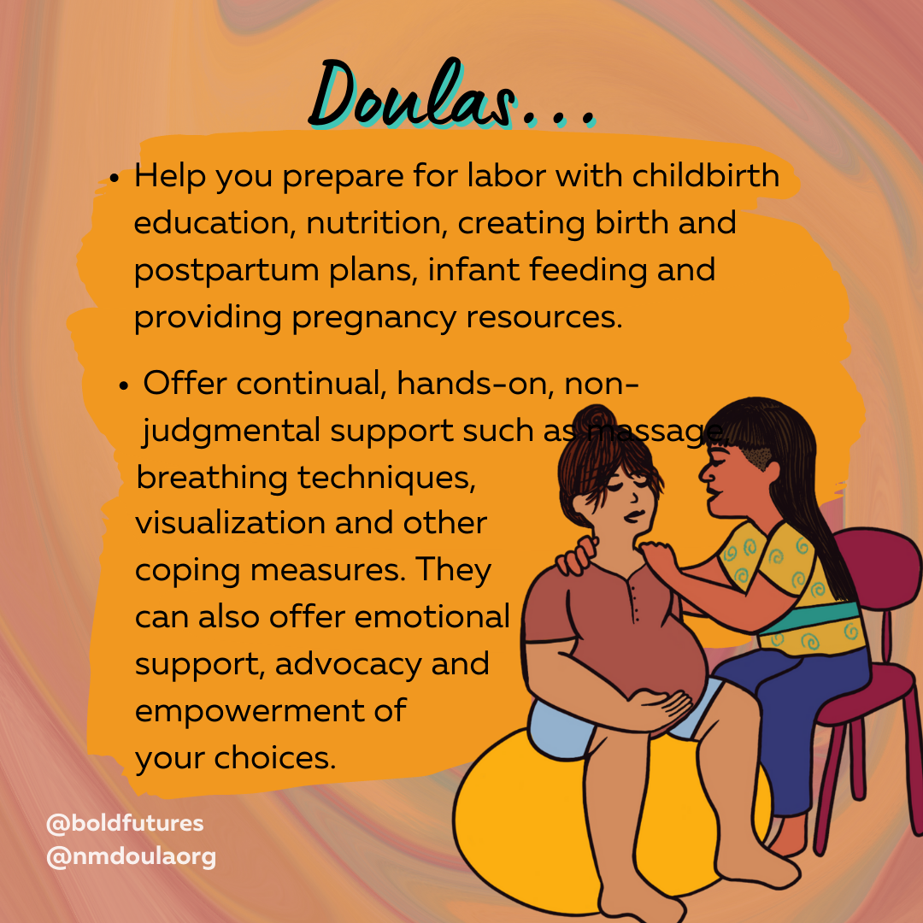
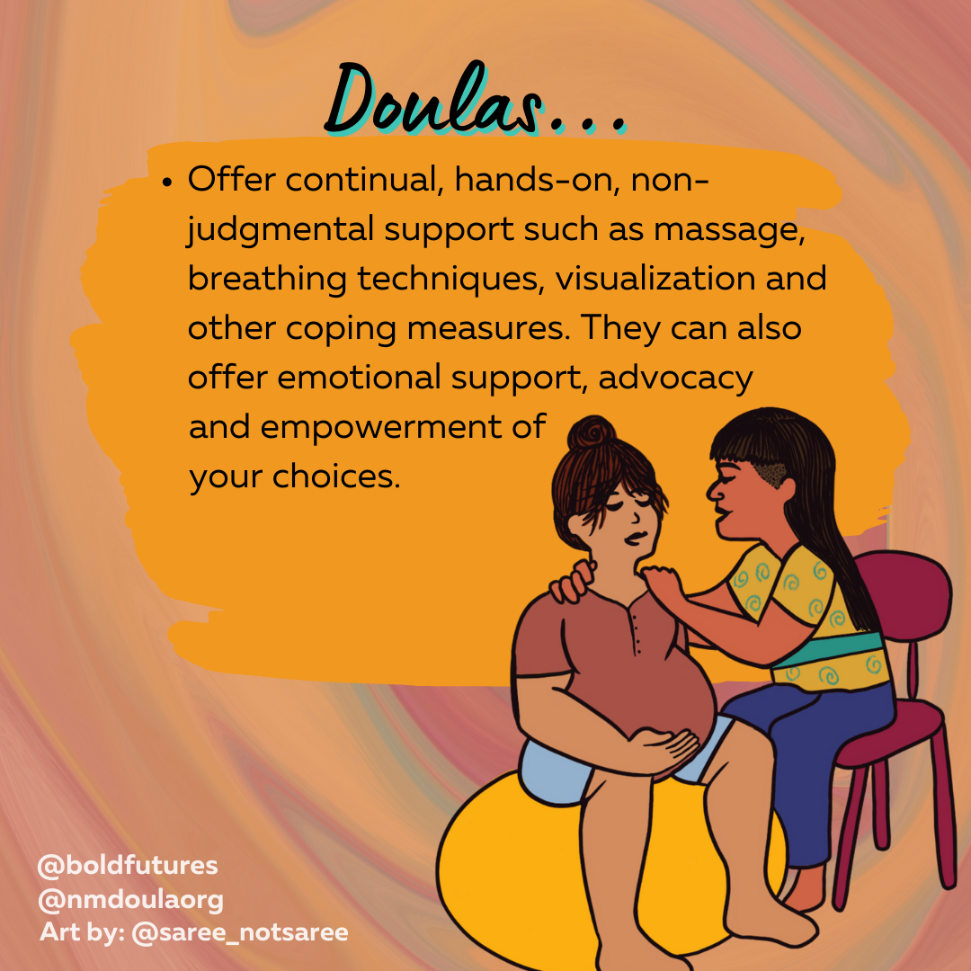
Notes:
Second bullet point only
Mention to Leslie to remove duplicate bullet point -

Slide 15
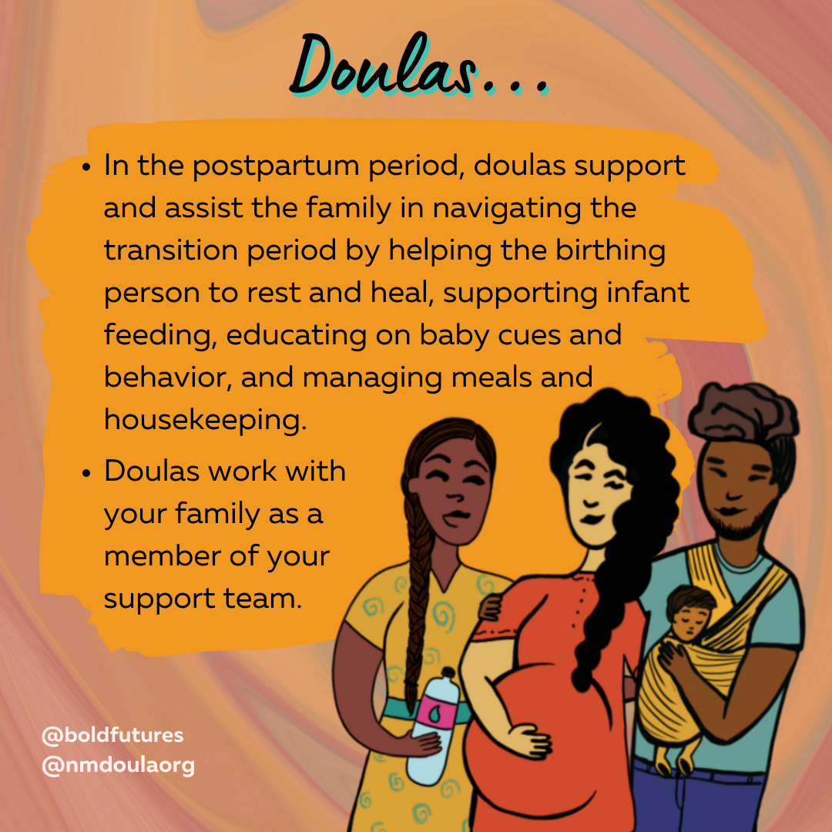

Slide 16
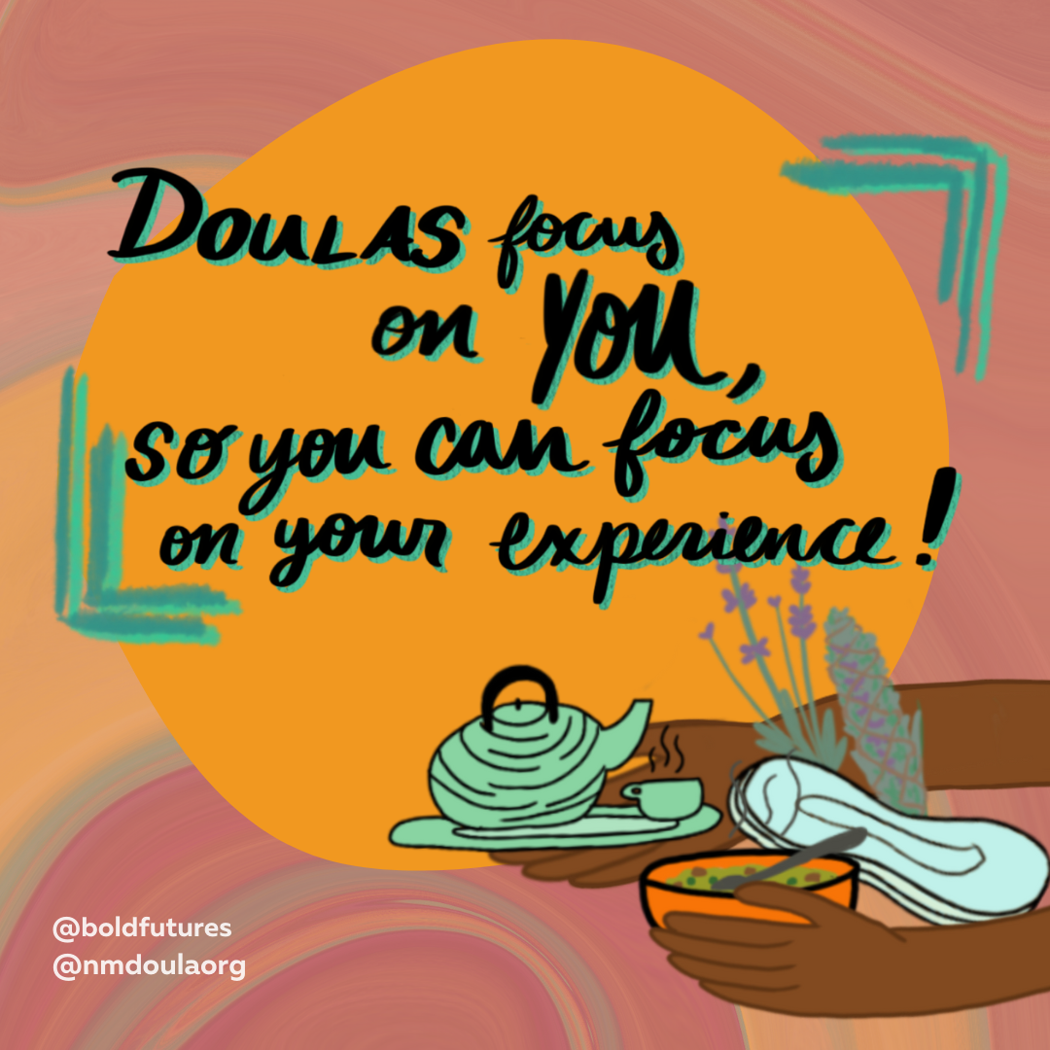
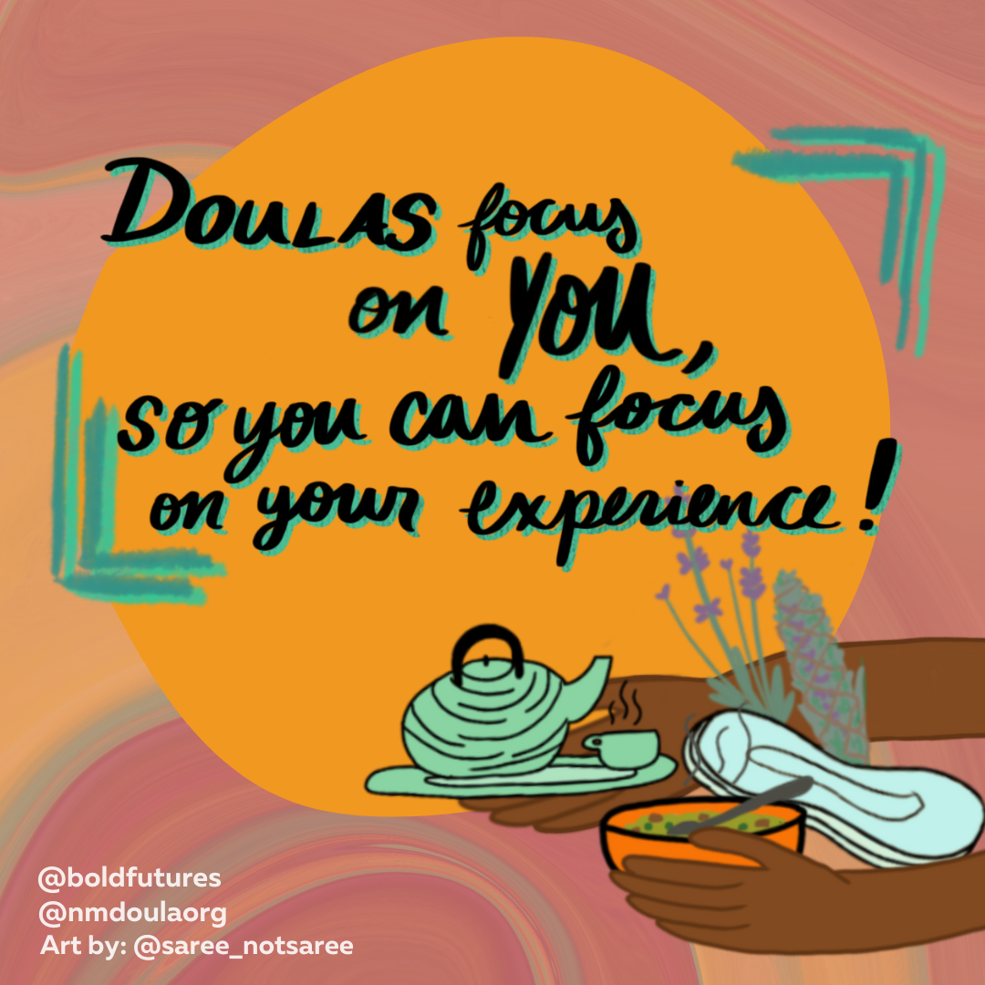

Slide 17
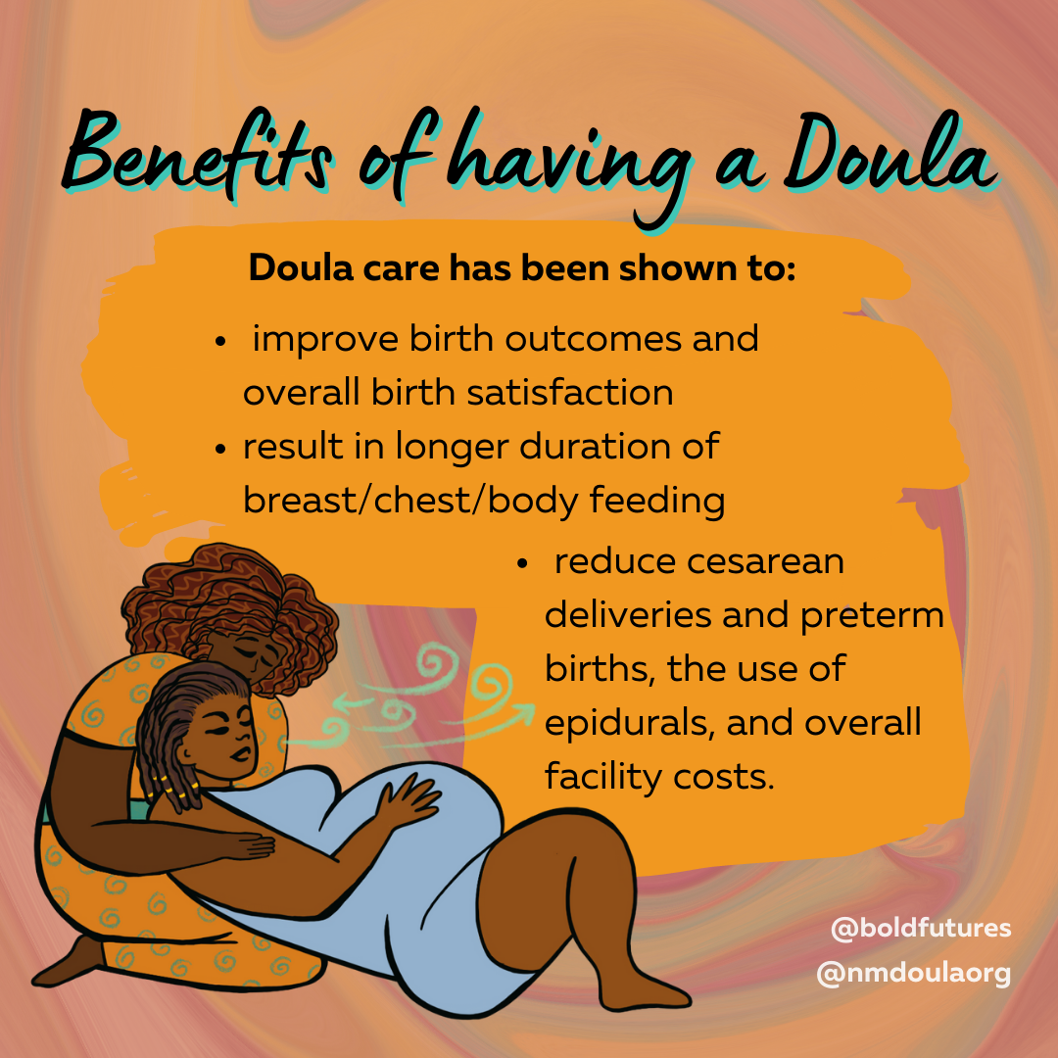
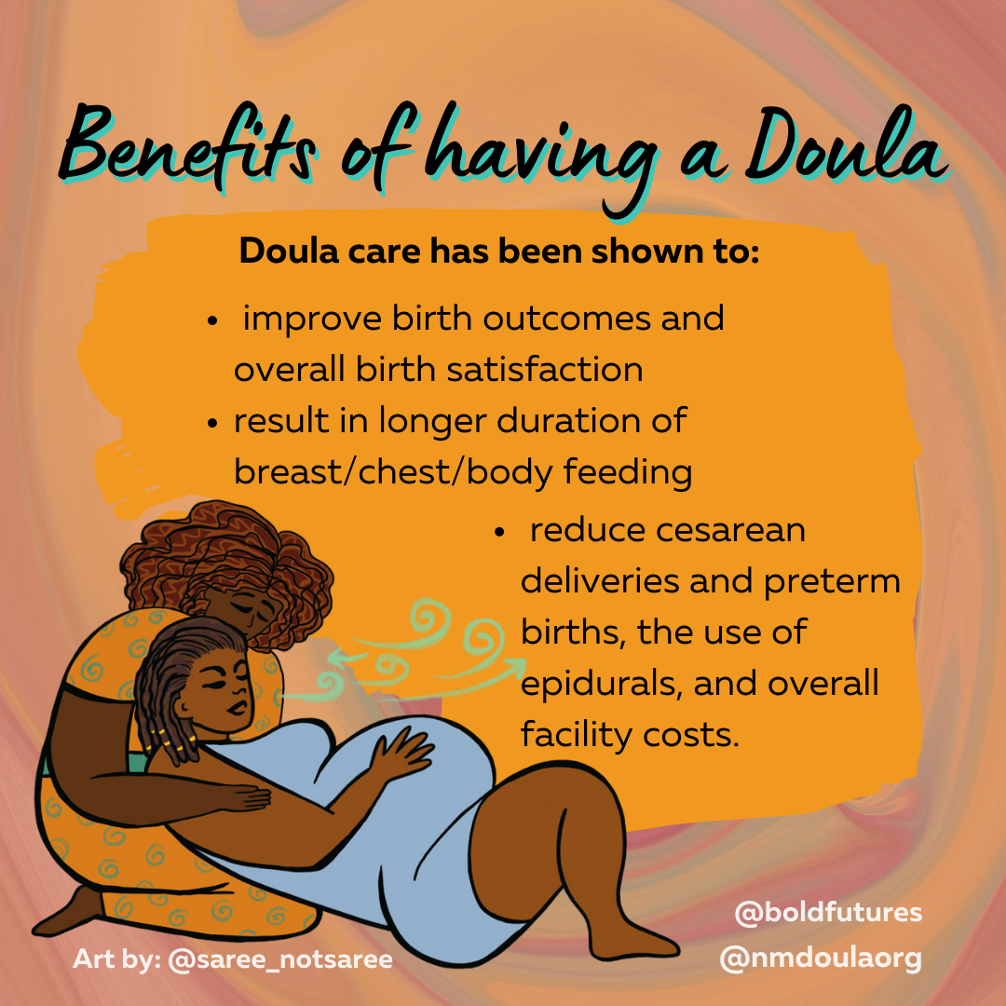
Notes:
Jesusita

Slide 18
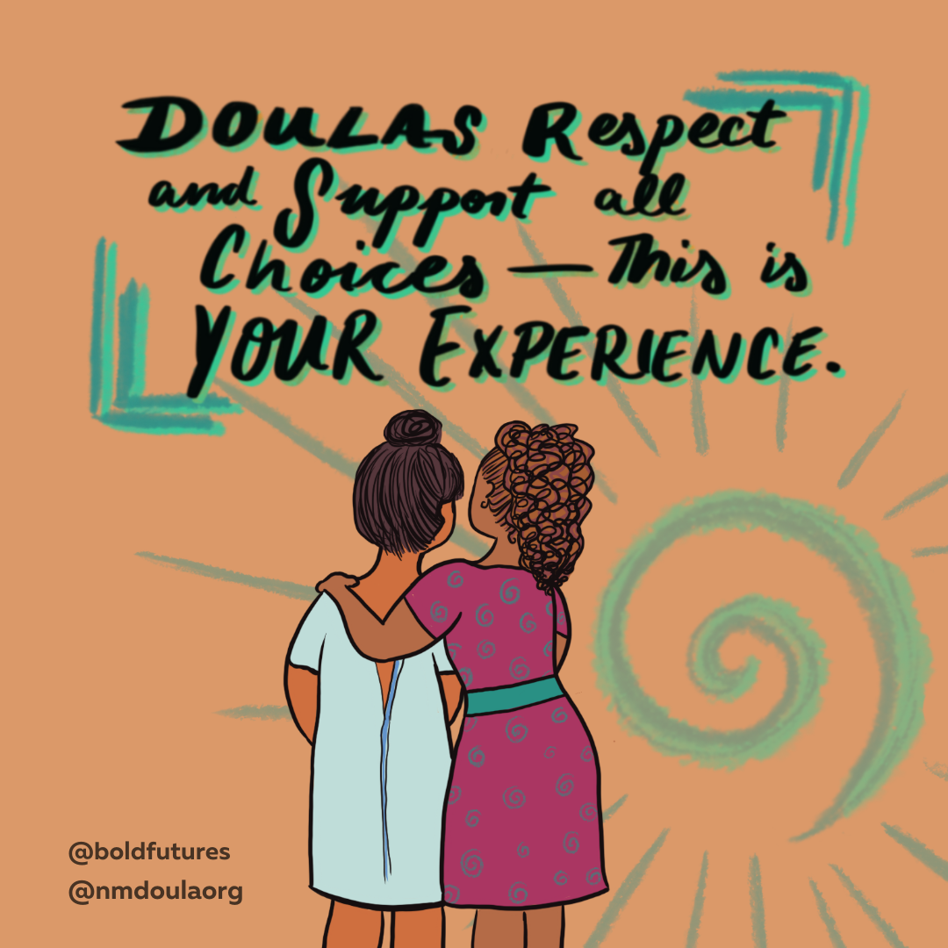

Slide 19
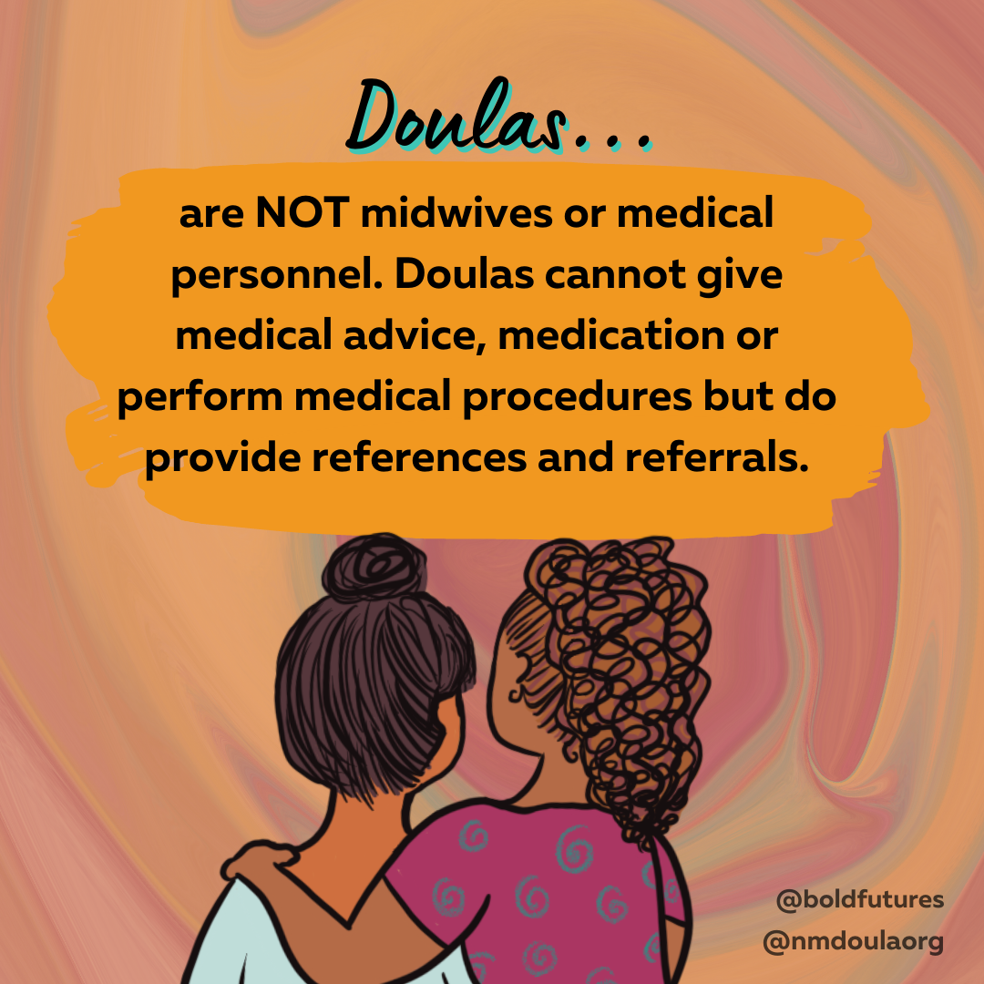
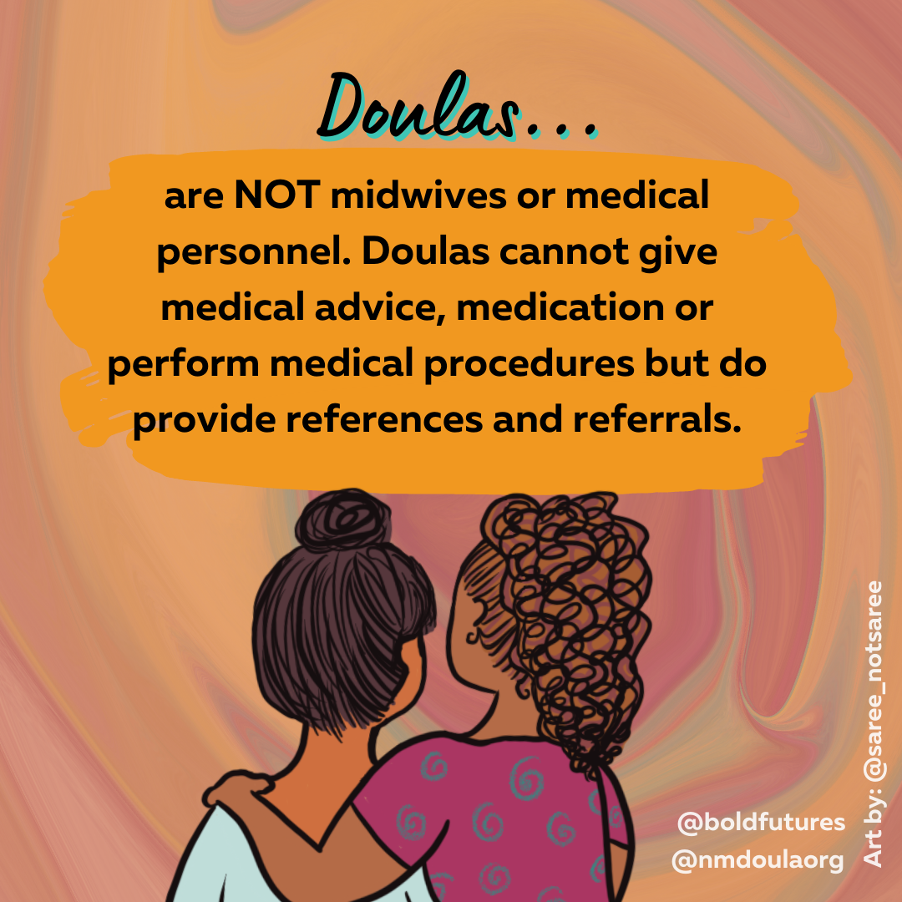
Notes:
Although Doulas have a variety of roles, it is important to note they are NOT

Slide 20
Notes:
Danica

Slide 21
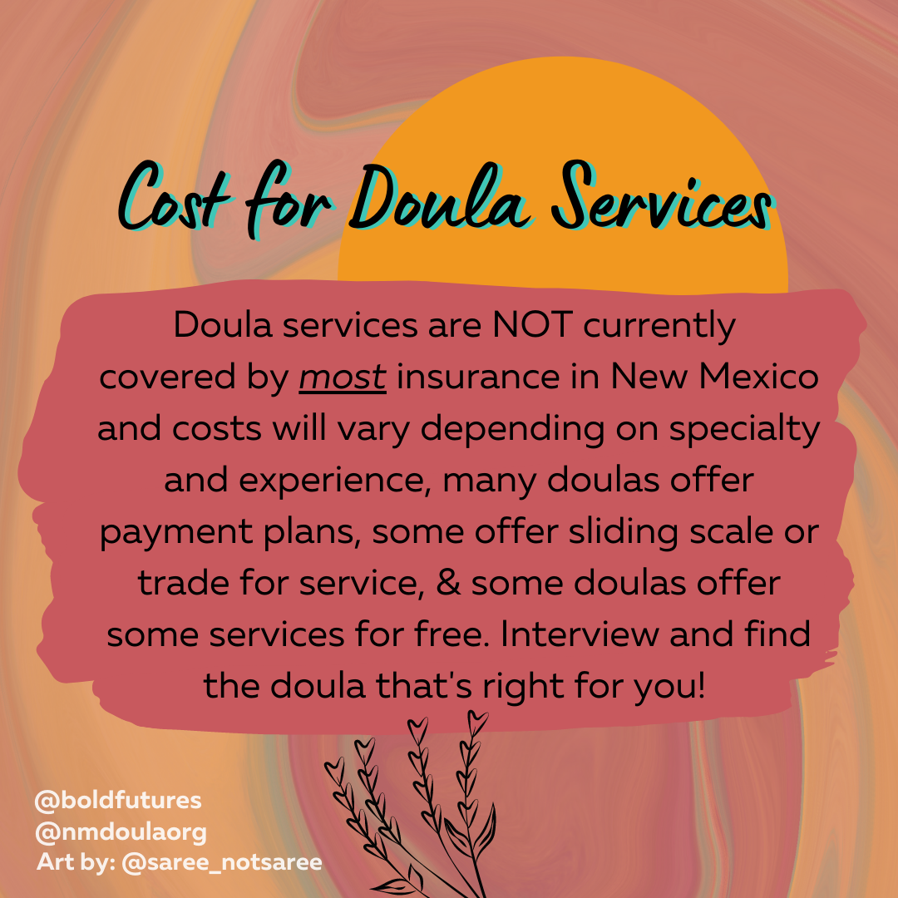
most
Notes:
Mention to Leslie to add ‘most’

Slide 23
Thank you
Notes:
Kathleen
Thank you for joining us today. We hope you now have a better understanding of the roles & importance of doulas & how we can be of support to you and our communities. if you are in need of support or have questions please feel free to reach out to the New mexico doula association or contact us directly

